Slide 1
Mr. Foster’s Capstone Project
Snowboarding

Slide 2
Why did I choose Snowboarding?
Snowboarding is a huge passion of mine. I’ve loved it since I was a kid, and switched out of skiing into it.
It’s really calming, and great exercise for the winter months, and is a really big passion of mine.

Slide 3
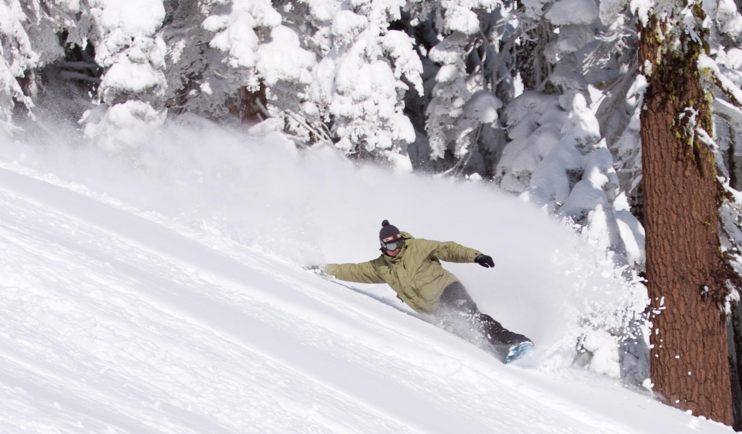
Session 1: Toe edge carving
I’ve had a hard time going from heel side to toe side, especially at high speeds.
This week I worked exclusively on carving by starting from the top of the hill, and doing small cuts up the mountain, getting a good range of what works and what didn’t.
Then I slowly increased the speed and decreased the distance of the carve in order to make better progress.

Slide 4
Session 2: 180 spin
My 180 spin goes fine, but it doesn’t look pretty.
My focus was to nail the aesthetics of the spin, so that it looked like I knew what I was doing.
I did this by finding the perfect jump on the hill, and repeating the motion and movement.
I recorded it on video to watch my movement and see where to improve.

Slide 5
Session 3: 360 Spin
This week I built on my 180, and worked on a 360 spin.
This has been a challenge for me, as I’ve struggled to get the momentum I need to turn all the way around.
I accomplished this by practicing at home on the carpet with my board attached, and then outside in the snow, and then finally on jumps.
I did the same method of filming my progress to see how I could improve.

Slide 6
Session 4: Rails
On this session I really focused on going on rails.
I wanted to be able to do a variety of rails, but I could only manage staying balanced on the flat rails. I kept falling off the others.
My goal is to work my way up to that level.

Slide 7
Session 5: Park Run
For the final session, I wanted to see if I could apply all the skills I learned and complete a successful park run with no bails.
I had to practice multiple times, and map out my route and what tricks I wanted to do where.
It took a lot of attempts, but I was able to do it!

Slide 8
What did I learn?
Persistence and perseverance.
180, 360, and some rails
Riding a terrain park with confidence.
A goal I still have is to get big air and land.

