Slide 1
The Wellness Wheel Project

Slide 2
Needs:
People’s health depends on meeting FOUR overall needs:
1.Physical (Body)
2.Mental (Mind)
3.Emotional (Heart)
4.Spiritual (Spirit)

Slide 3
Dimensions of Wellness
Physical Dimension (Body)
  Exercise, eat healthy, sleep well, relax
Mental Dimension (Mind)
  Read, educate, write, learn new skills
Emotional Dimension (Heart)
  Develop good interpersonal relationships, give service, laugh
Spiritual Dimension (Spirit)
  Mediate, keep a journal, take in quality media, reflect

Slide 5
8 Categories
Nutrition
Fitness
Leisure
Relationships
Positive Risk Taking
Stress Management
Life-long Learning
Environmental Sensitivity

Slide 6
Categories
Nutrition
Fitness
Good eating habits
Maintaining healthy weight range
Not overindulging, or relying on unhealthy food groups
Energy drinks, high salt or sugar content, bad fats in food, et
Could lead to cardiovascular disease, blood clots, et.
Respecting and caring for your body
Exercising regularly to maintain health
Increasing heart rate is a goal
  30min/day
  150min moderate – vigorous
Could lead to lasting negative health conditions if ignored
Should be fun for you

Slide 7
Categories
Leisure
Relationships
Taking time for yourself
Balancing interdependence of physical and emotional well-being
Stuff you do for fun, relax, wind down, release energy, et
Learning is a social process
Emotional awareness and coping for self and others around you
  Recognize a friend is acting out?
  Recognize yourself getting angry?
Willing to share, cooperate, form friendships, and respect others
Humans were designed to need others
Who supports you/who can you turn to?

Slide 8
Categories
Positive Risk Taking
Stress Management
Responding to challenges in life as opportunities to grow/mature
  Do you shut down, or push through?
Helping yourself feel confident, secure, valued and cared for
Why are you doing this?
  For you? For popularity? To fit in?
  Is this healthy or good?
Ex: trying to present in front of the class vs lighting fireworks in the classroom
Understanding importance of emotions and regulating them
Respond to change in a responsible manner
Flexibility and Adaptability
Ongoing/constant, not a check mark and done

Slide 9
Categories
Life-long Learning
Environmental Sensitivity
Enjoying the process of making mistakes, and learning from them
Feeling pride & success in accomplishments
Growing as a person, and accepting that change
  High school you vs 30 year old you
  Party Friday night vs buying a vacuum
Respecting and caring for the environment
  Don’t need to protest or hug trees, just do your part
Being aware of global community and needs
How are you impacting the world around you?

Slide 10
The Hub/center:
Personal Responsibility
The Rim:
Spirituality
Finding purpose and meaning in your life
Exploring your role in the world
Renewing and awakening yourself
Recognizing your actions and their consequences
Developing personal integrity
Accepting responsibility for your own decisions and actions
  The test’s fault or yours for not studying?
  Bad teacher or constant skipping?

Slide 11
So what does this look like?
Pull out the criteria booklet!

Slide 12
Student Examples

Slide 17
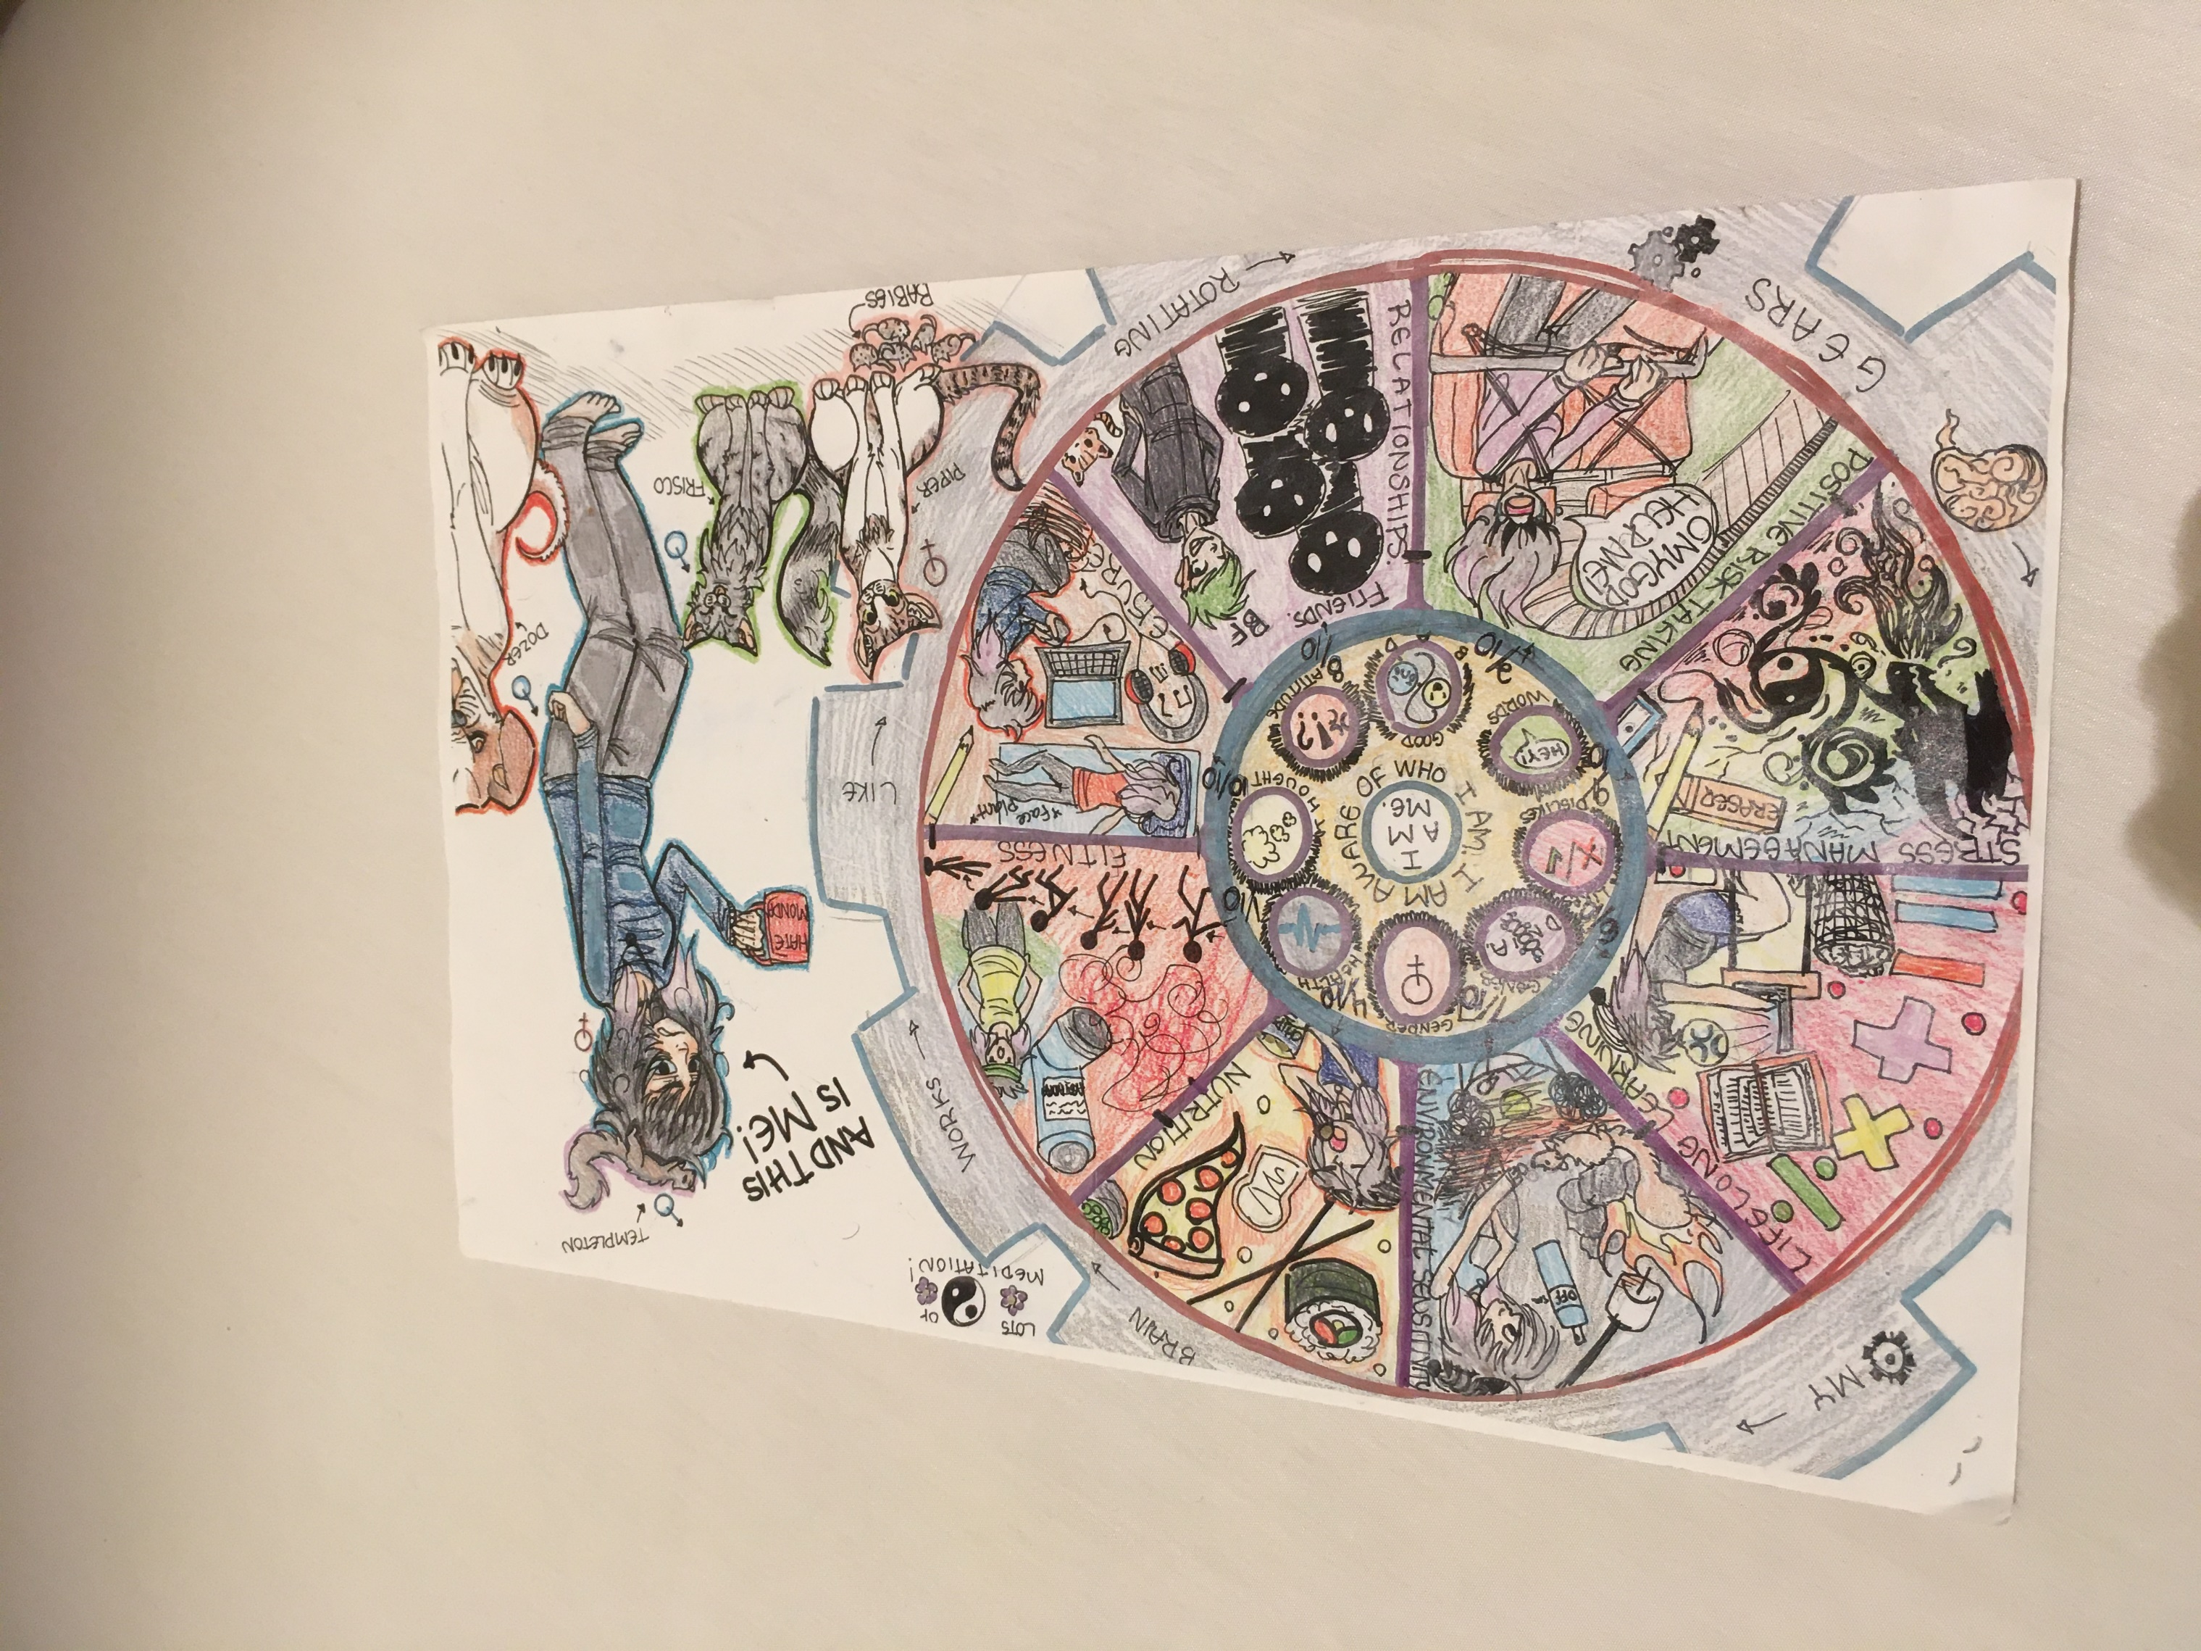

Slide 18
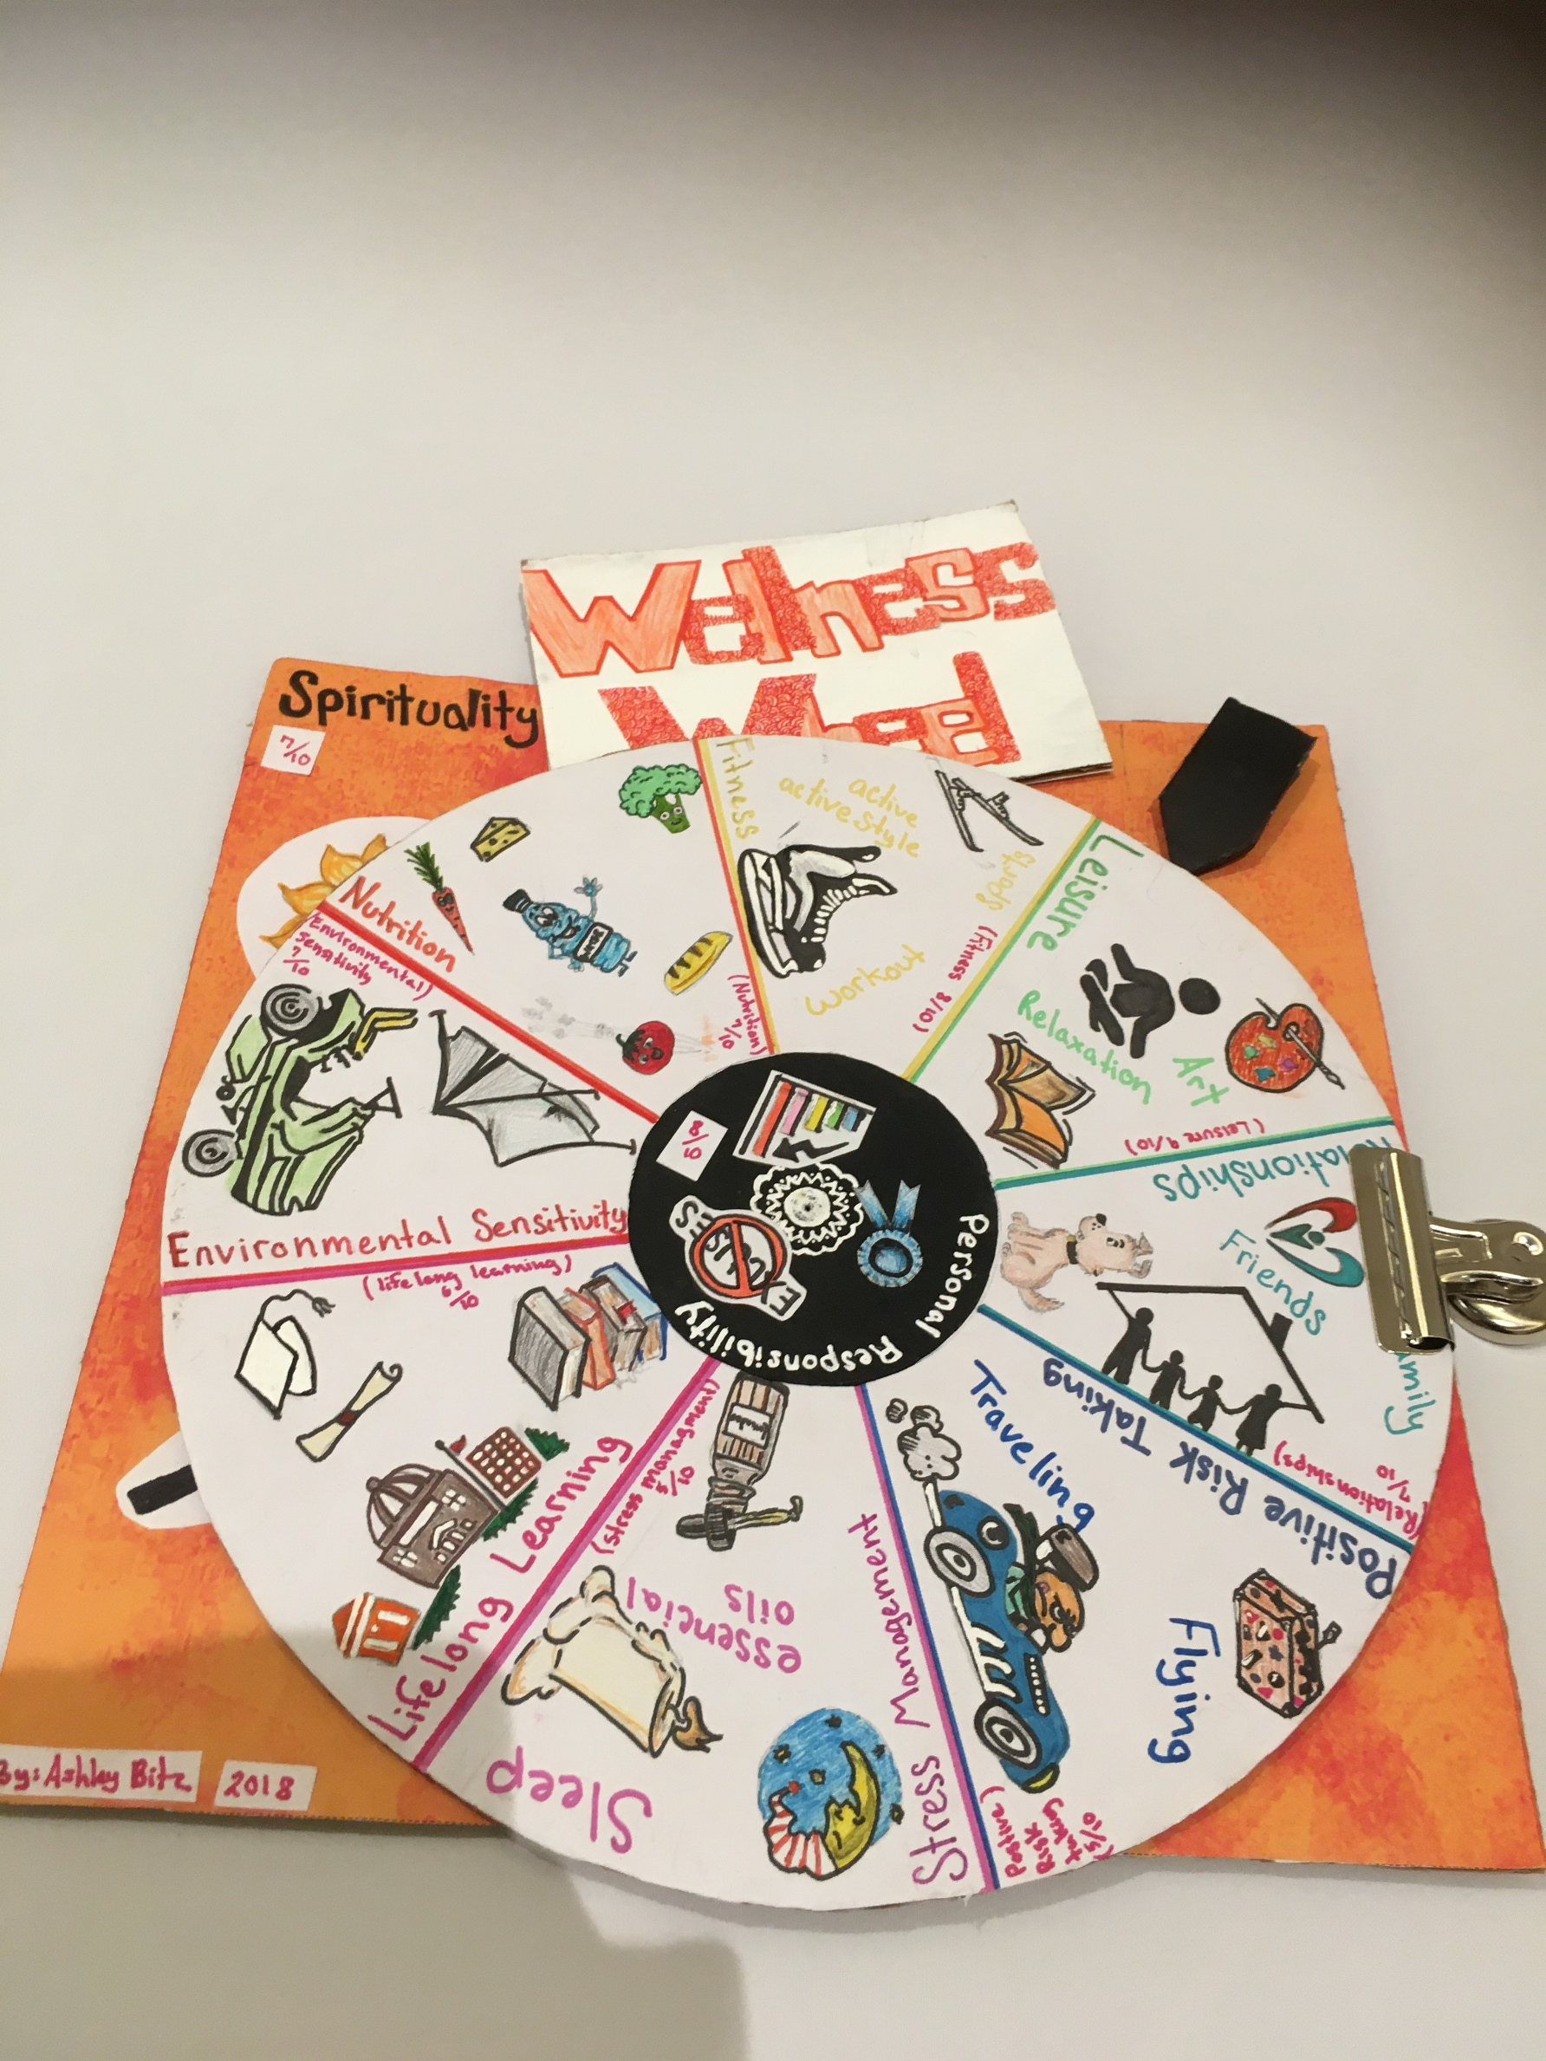

Slide 19
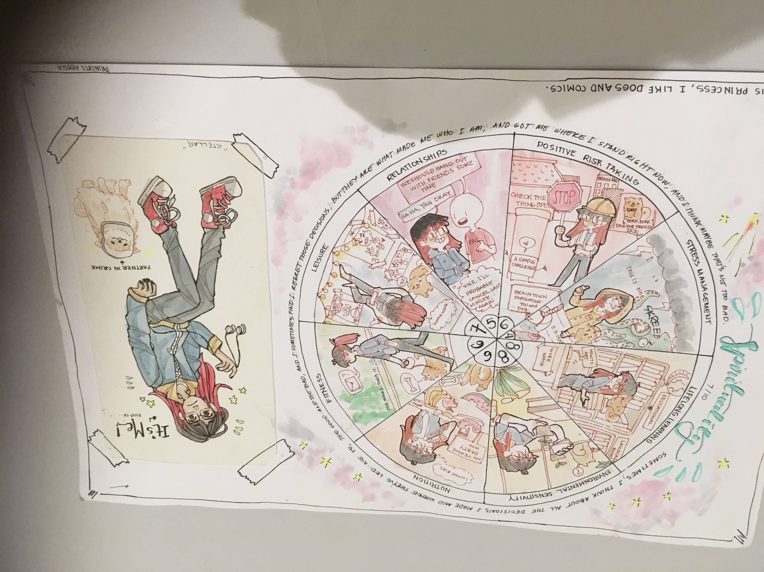

Slide 20
This wheel represents YOU

